Slide 1
Collecting a Research Library
Dr. Capo, Dr. Trotman & Stacey Allsop, MLS, MIS
Notes:
NOTE:
To change the image on this slide, select the picture and delete it. Then click the Pictures icon in the placeholder to insert your own image.

Slide 2
Where Not to Begin and Where to Begin!
Limit Web Resources!!!! (Do not begin on the Internet!)
Learn to effectively use the Library databases
Learn to use search terms efficiently
Use the thesaurus for variations of search terms
Search for peer reviewed articles
Search for some current dissertations

Slide 3
Peer Reviewed Articles
Start with the most current articles
Read the abstract first and if it appears to be useful to your topic, pull the article and citation
Evaluate your sources
Do not select articles because you agree with them!!!!!!!!!

Slide 4
The Hunt for Information
Keep notes and the research articles, either paper based or digitally.
Make sure you clearly label notes as paraphrased or quotes (with page numbers and citations).
Do not get rid of any research articles that you use!

Slide 5
Notes
Keep a Journal either digitally or on paper, or both.
Write down ideas!!!!!
Get organized!
Keep files!
Make a database!
Prepare to work through personal time.
The more you work, the faster you will get done!

Slide 6
Review Reference Lists to Locate
Government Reports and other reports that are referenced in peer reviewed articles.
Theoretical references (usually include older references than five years).
Papers from professional organizations.
Conference proceedings

Slide 7
Secondary Sources
Avoid citing secondary sources! Find the original and add it to the citation after you have read the original research!
Reserve secondary sources for out of print work!
Ca
(as cited in Jones, 2005)

Slide 8
Cited By!
Look up who has cited the important research articles you have found.
This is a way to keep your research current!

Slide 9
Landmark Articles
Very Important!
If a source is cited in many of the research articles you read, then it may be a Landmark research article and should be cited in your literature review.
Ex. Prenksy (2006) is usually cited in any study that focuses on Digital Natives.
Cited by: (351)

Slide 10
Also Look for the Following
Analyze the Theoretical Frameworks discussed in the articles.
Make notes of the articles and the names of the Frameworks.
Keep an eye out for possible instruments and note these as well.

Slide 11
Other Good Sources to Ask for Direction!
Professional Associations
Conferences
Experts in the field

Slide 12
Digital Libraries and Databases
EndNote
Import citations
Attach the articles
Add research notes
Share capabilities
Academic Writer (formerly known as APA Style Central)
Import citations
APA Formats your writing
Collaborative capabilities

Slide 13
Digital Libraries and Databases
Google Scholar search
Link+ catalog and electronic requests
WorldCat catalog
ProQuest Dissertations database
Interlibrary loan electronic requests

Slide 14
Support Services: Connecting with an NSU Librarian
Ask a Librarian by phone, email, or chat at the Reference Desk:
Monday–Thursday 10am-8pm Saturday 12pm-8pm
Friday 10am-6pm Sunday 11am-7pm
30-minute appointments are available upon request at:
http://lib.nova.edu/ask
Library Workshops are offered throughout the semester:
http://lib.nova.edu/workshops

Slide 15
Adding to your Literature Database
Endnote
https://nsufl.libguides.com/EndNoteX9
Getting Started
EndNote is a great resource for storing, organizing, and formatting your references. But before you start to use EndNote, you will need to follow all of the steps in this section for setting up and customizing the software, so it works correctly with the library databases and the citation styles that you need.
Step 1: Checking Compatibility
Step 2: Downloading EndNote: Windows or Downloading EndNote: Mac
Step 3: Creating a New Library
Step 4: Choosing Citation Styles
Step 5: Selecting Import Filters

Slide 16
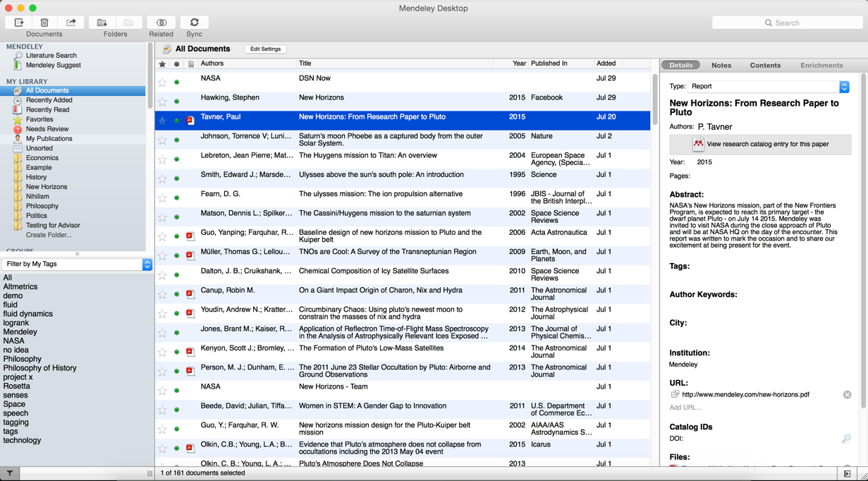
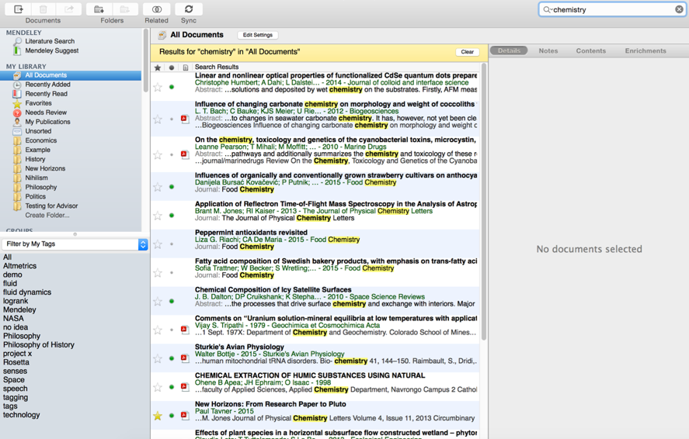
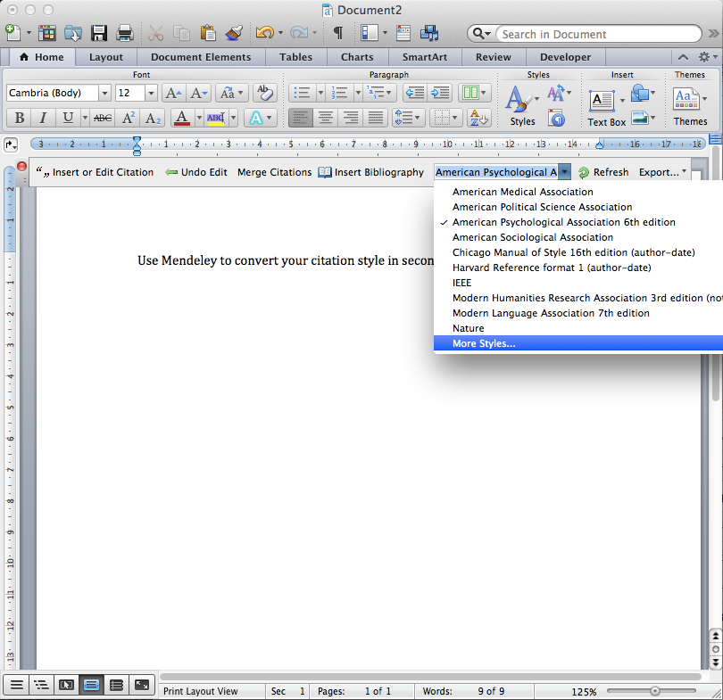
How does a free Mendeley Research App Help?
Find research articles, organize a review of literature
& cite it correctly.
wgisele@nova.edu
Gisele Waters, Ph.D
Notes:
Mendeley acts as a repository for your reference information. You add papers to your library by importing PDF files stored on your computer, or by retrieving them from other locations - like online catalogs such as ScienceDirect, Scopus, Pubmed or PLOS. You can also create entries for items that you don’t have access to as PDFs by manually entering details.
Materials you add to your library are then stored in the cloud, for you to retrieve wherever you need them. It might be that you want to read a paper on the way home on the train, or you need to write a paper on your main computer. Mendeley allows you to retrieve the same resources with the same enhancements and annotations wherever you need them.

