Slide 1
Job & internship search
Presented By: Career Development

Slide 2
Career Development
Brief Overview
Career Development serves to support Nova Southeastern University's undergraduate students, graduate students, and alumni in the implementation of successful career planning.
All students are encouraged to participate in career advisement, opportunities to meet employers, and assistance with preparation for the job or graduate school search.

Slide 3
Career Development Services
Resume, CV & Cover Letter
Career Exploration
Strategic Action planning
Job Search Assistance
Networking
Mock Interviews
Residency Applications
Grad School Applications
Personal Statement
Internship Assistance
Salary Negotiations
Career Exploration
LinkedIn & Personal Branding

Slide 4
Type of Events & Workshops
Professional Development
Resume, Cover Letter, Networking LinkedIn, Improv Public Speaking, Building Your Brand and many more
Employer Events
Bi Annual Career Fair, Resume Review, Mock Interview Nights, Network After Class & Employer Panels/Networking Opportunities
Experiential Learning
Case Competitions, Employer Visits, Pre Health Day & Lunch Bytes

Slide 5
Job & internship search overview
Know yourself!
Passions and interests as it relates to the position
Do an inventory check: Identify your strengths, skills and weaknesses
Understand the nature of the work and fit for the position
Knowledge base & Transferable Skills
Have a strategic plan for your job search
Understand your brand and market it

Slide 6
Preparing for your search
Identify your resources! (Handshake, Career Fairs, Indeed, Higher Ed Jobs, Academic 360, Networking LinkedIn, and other job search platforms)
Know your skill set!
Decide what culture and environment you want to work in
Schedule an informational interview; gather information about the occupation and develop key relationships
Create an excel spreadsheet (list all Jobs you’ve applied to)

Slide 7
Networking through events
Networking is the exchange of information or services among individuals, groups or individual institutions. A mutual exchange of information, a referral system.
80% of the jobs that we find are through networking
Meeting others through events can lead to possible job and internship opportunities (hidden job market)
1.) Networking After Class (NAC)
2.) Career and Internship Expo
3.) Informational Interviews
4.) Local or National Networking Events

Slide 8
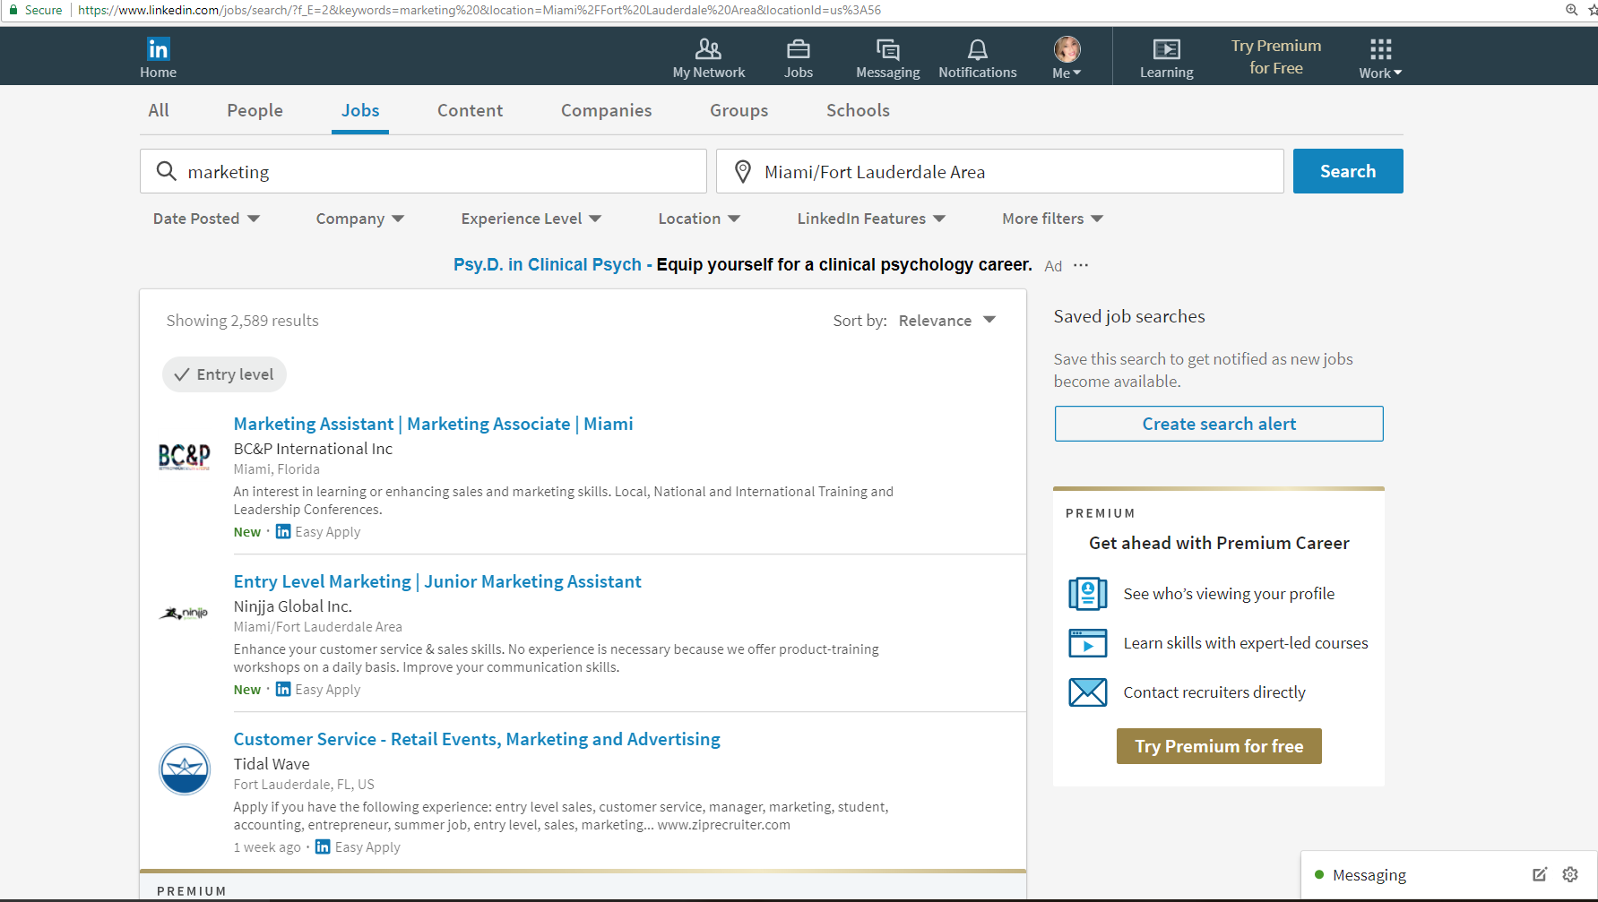
linkedin
LinkedIN is a networking tool to communicate and connect with experts in the field
80% of jobs and internships are found through word of mouth and by being at the right place at the right time, by networking!
Filter by location (city, state) and job type
LinkedIN: https://www.linkedin.com/feed/

Slide 9
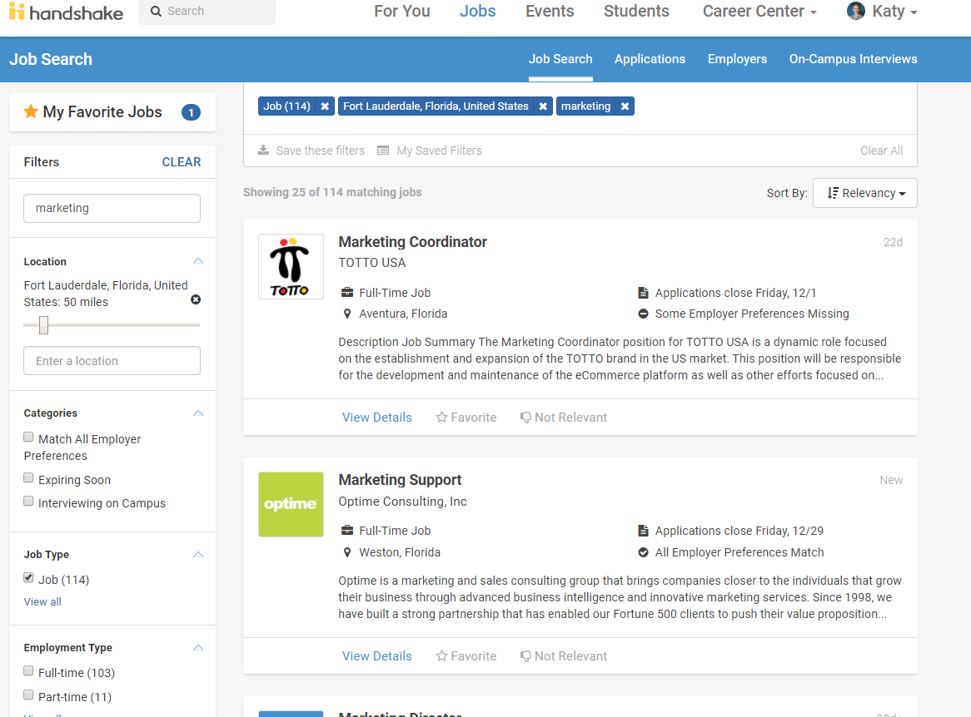
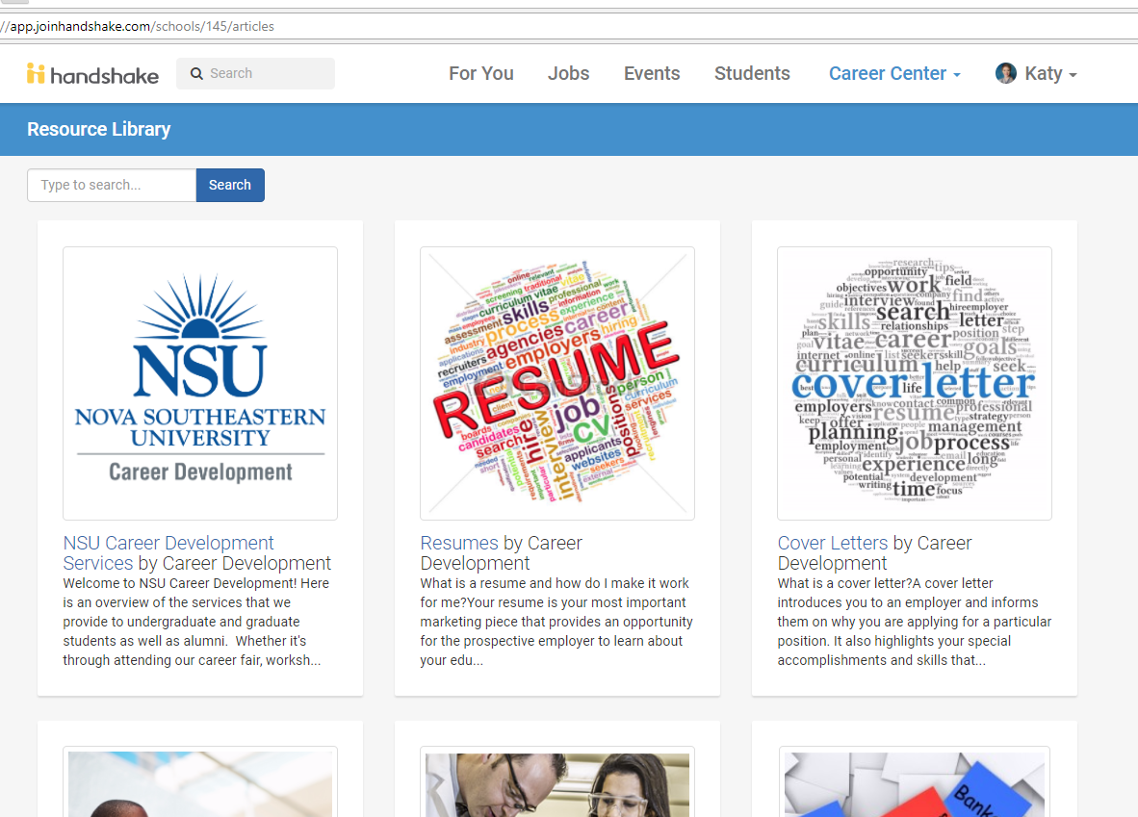
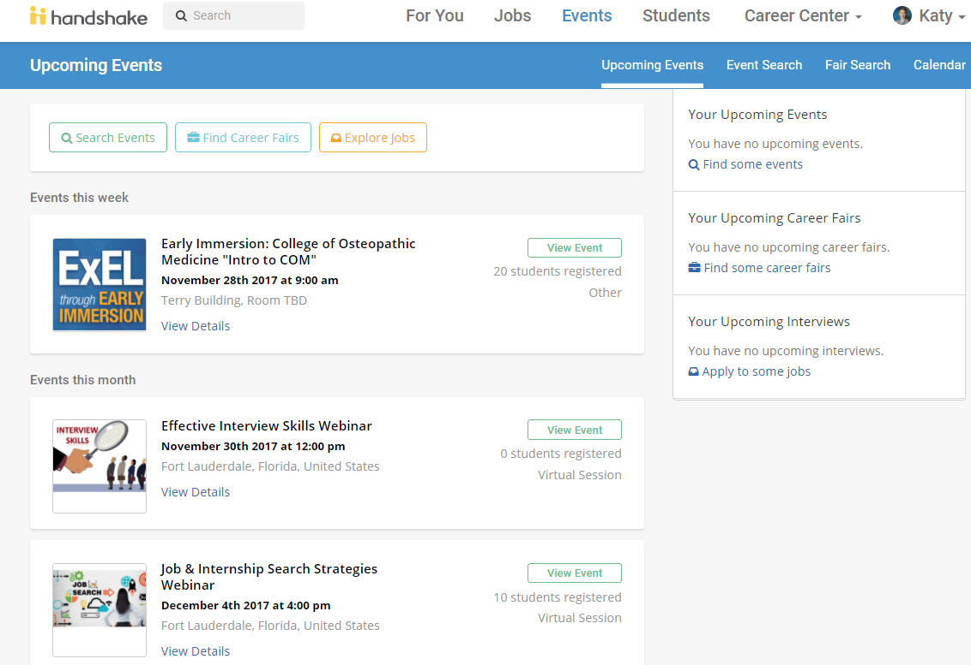
Handshake
Career one-stop shop for jobs and internships
Explore majors and careers
Sign up for workshops and events
Learn about career expos
Connect with employers
Find job and internship opportunities
HandShake: https://nova.joinhandshake.com/

Slide 10
Additional job sites
Indeed
Higher Ed Jobs
Higher Ed 360
Topschooljobs
Glassdoor
SimplyHired
Snagajob
ZipRecruiter
Internships.com
Targeted Search- visit the company website to see jobs and internships opportunities that may not be listed on Indeed.com

Slide 11
Evaluating the job market
Be proactive!
Create a HandShake and LinkedIN account
Start connecting and networking with others
Schedule informational interviews
Visit glassdoor.com to review the company
Interview questions
See what others are saying
Visit salary.com or NACE Salary to get a better insight on salary based on experience, education, and location
Plan ahead!

Slide 12
Basic tips and tricks on a resume
0.5 margins
Name-18-20 size font
Resume- 10-11 size font
Times New Roman
Remove objective and references
Bullet points- start with a STRONG action verb!
Use job description to develop your resume content

Slide 13
Resume: Do’s & don’ts
DO:
Make your name stand out by making your font size between 18-20 size point font
Use strong action verbs to elaborate on what you did in that position or experience (An employer wants to see quantifiable results and outcomes through your bullet points)
DON’T:
List your martial status, age, religion or hobbies
List any “hard” skills within your KEY SKILLS section unless you know the material (anything is fair game for an interviewer to ask you regarding your resume)
Put periods at the end of your bullet points
Use a resume template

Slide 14
Sample Resume

Slide 15
Sample Resume

Slide 16
Sample Resume

Slide 17
Basics of a cover letter
The “pre-interview”
0.5 margins (all around the document)
10-11 size font for rest of cover letter
Explain how you heard about the job and why you’re excited to work for this organization
Do your research by visiting the companies website and read about their core values and see if they align with your goals (make sure you’re a good fit for them, and they’re a good fit for you.)
By adding a piece about the company shows that you’ve done your homework!

Slide 18
Make your appointment today!
HOURS OF OPERATION
Horvitz Office
(1st Floor of the Horvitz, Room 152) Mon- Fri. 8:30 a.m. - 5:00 p.m. Sat- Sun- Closed
DeSantis Office
(Carl DeSantis Building, Room 1042) Mon- Fri. 8:30 a.m. - 5:00 p.m. Sat- Sun- Closed
Career Advisement Office
Please call: 954-262-7201

