Slide 1
Identifying Directions for Research
Dr. Capo and Mrs. Fernandez

Slide 2
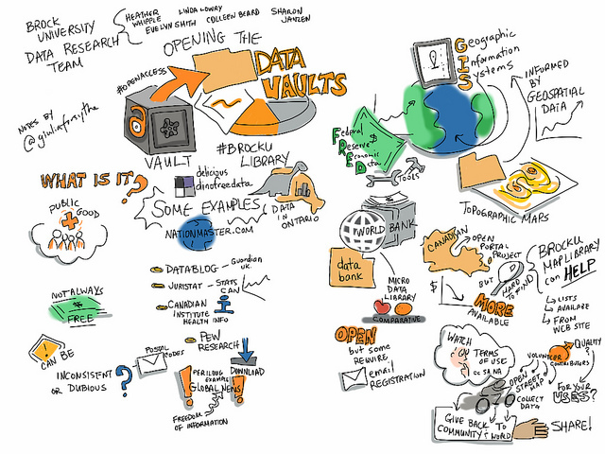
Searching for Research Possibilities
Begin pulling research articles related to your topic
Pull dissertations
See what has already been done
Look for Gaps

Slide 3

Library Databases
Your best source for current peer reviewed research.
Learn to utilize the databases effectively
Start with the most current research

Slide 4

Searching for Research Possibilities
Search through journal articles or recent dissertations for recommendations for future research
Recommendations are usually found in the discussion or conclusion

Slide 5
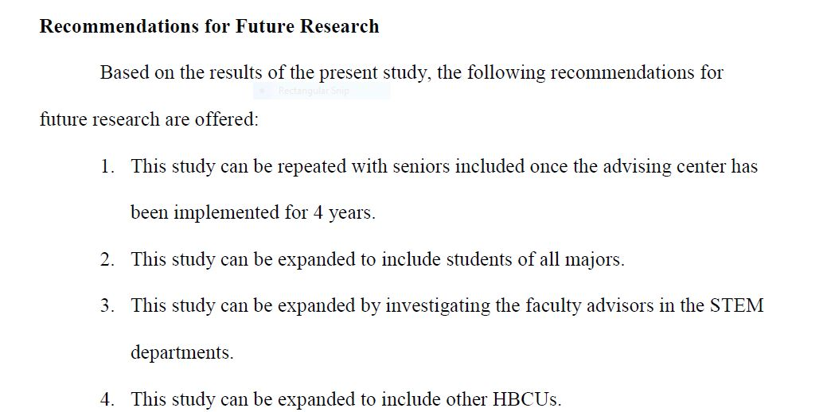
Research and Recommendations

Slide 6

Possibilities and Replicating Research
You have a different population
You wish to use a different methodology or theoretical framework to learn more about a phenomenon
The researcher(s) state that further research is needed (limited research)

Slide 7

Research Topic Considerations
Must be something you are very interested in researching
Must be highly related to your major
Should be important

Slide 8
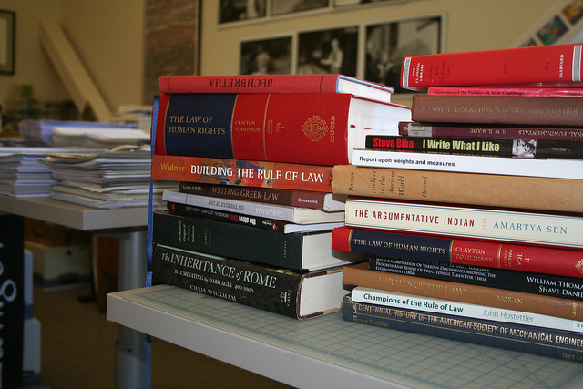
More Research considerations
Cost
Uniqueness
Need
Time
Difficulty
Should be feasible
Must be ethical

Slide 9

The Problem
Narrow your topic to a Problem Statement!
What exactly is the problem?
Must not be too broad or too narrow.
EX. Students’ attendance rate in X school in a southern state has declined by 20 % since the 2016/2017 school year.

Slide 10
References
Martin, B. (2014). Minority STEM students' perceptions of academic advisement and the impact of academic advisement on satisfaction and academic success of minority STEM students at an HBCU in southeastern Louisiana (Order No. 3666736). Available from ProQuest Dissertations & Theses Global. (1640917921). Retrieved from http://search.proquest.com.ezproxylocal.library.nova.edu/docview/1640917921?accountid=6579

Slide 11
Contact Information
Dr. Berta Capo
cbertanova.edu
Joana Fernandez-Nuñez joana.Fernandez@nova.edu
David Weintraub
daweint@nova.edu
Anne Joslin
joslina@nova.edu

