Slide 1
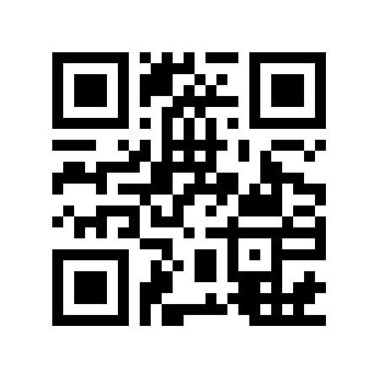
Writing Chapter 3 and Locating Instruments
Jennifer Reeves, Ph.D.; Katrina Pann, Ph.D.; & Laura Ramirez

Slide 2
Methodology
The Methodology specifies how you are going to address the research questions.
Only included in the Proposal and Final AD
Be as detailed as possible
Use the templates posted on the website to help guide you (https://education.nova.edu/applied-research/research-and-dissertation-resources.html )

Slide 3
Chapter 3 – Quantitative
Introduction/Overview of the Study
  Include the Purpose Statement
Participants
  Population, Sample, Sampling Procedures (and justify with a citation!)
Instruments
  Provide details about ALL instruments used to collect data
  Be sure to include detailed descriptions of
    Development (use of formative and summative committees)
    modification permissions,
    scales/response options,
    psychometric properties
    Pilot test

Slide 4
Chapter 3 – Quantitative
Procedures
  Research Design (justify with a citation!)
  Data Collection Procedures (step-by-step details)
  Data Analysis Procedures (detail how you plan to answer each RQ)
Limitations
Anticipated Outcomes*

Slide 5
Chapter 3 – Qualitative
Aim of the Study/Overview of Chapter
Qualitative Research Approach
  Background, why this specific approach (rather than a quant approach or different qual approach), how it guides your study (with expert citations!)
Participants (how many, selection criteria, discuss saturation)
Data Collection Tools (e.g., interview or focus group protocol, questionnaire, documents)
  Describe development of tools in detail, including expert review and pilot test
Procedures

Slide 6
Chapter 3 – Qualitative
Data Analysis
  Discuss transcription and organization as well as coding, pattern, theme development
  Use strategy and language consistent with specific approach (with citation!)
Ethical Considerations (how you will preserve confidentiality, keep documents secure, etc.)
Trustworthiness (discuss strategies such as member checks, peer review, thick description, audit trails)
Potential Research Bias (your own bias and plan to manage it)
Limitations

Slide 7
Chapter 3 – Mixed Methods
Introduction/Overview of the Study
Participants
  Quant/Qual
Instruments
Procedures
  Research Design
  Quant/Qual Data Collection Procedures
  Quant/Qual Data Analysis Procedures
  Data Integration – how the data will be merged
Limitations

Slide 8
Select a Reliable and Valid Survey Instrument
Check the Tests & Measurements Databases at the library
Mental Measurements Yearbook with Tests in Print (Produced by the Buros Center at University of Nebraska)
HAPI - Health and Psychosocial Instruments
PsycTESTS
Look in published journal articles
Run an ERIC search and a descriptor for the instrument you want in an online search to see if there are articles that contain instruments
Search the Dissertations databases to see what instruments other doctoral students used

Slide 9
Develop a Survey Instrument
What if you can’t find an appropriate existing instrument?
  You have to develop your own!
Here’s a recording of the Survey Development workshop from Winter term: https://attendee.gototraining.com/anytimetrainings/%0b4837153369134337025/registrants/3967269247567606274/anytime.tmpl

