Slide 1

Writing a literature Review
Kelly Concannon, Ph.D.
Fischler College of Education
Summer Institute for Doctoral Students
July12, 2019

Slide 2
Writing a Literature Review
This workshop will engage participants in activities designed to help them begin writing their literature reviews.
Topics will include:
Narrowing focus, clarifying purpose, organization, summary, and synthesis

Slide 3
writing process
prewriting
writing
editing / proofreading
rewriting

Slide 4

Understand your writing and research processes:
How much time do you designate to reading?
How much time do you designate to writing?
What kind of environment do you need?
Notes:
http://equip.sbts.edu/article/20-tips-to-help-you-finish-your-dissertation/

Slide 5

set blocks of time*
Notes:
https://giphy.com/gifs/thehills-3o6Mblpo7jq1JBaXLi

Slide 6
Defining a Literature Review

Slide 7
What is a Literature Review?
As a piece of writing, the literature review must be defined by a guiding concept (e.g., your research objective, the problem or issue you are discussing, or your argumentative thesis).
The literature review is not a description, but rather is both a summary and an analysis of outside materials
The literature review points to gaps/inconsistencies

Slide 8
Defining Parts of a Literature Review
A Literature Review must do the following things:
  Frame an overall point of inquiry/ research question;
  Synthesize results into a summary of what is and is not known;
  Identify gaps/ disconnects in the literature; and finally,
  Formulate questions that need further research

Slide 9
Framing your Point of Inquiry

Slide 10

How do I frame my research?
Narrow your research topic through the following approaches:
    Time
    Location
    Population
    Trends

Slide 11
Synthesis

Slide 12

Locate Relevant Sources:
Review your previous work in courses for pertinent materials
Engage in conversation with colleagues and scholars in your field
Make an appointment with a librarian

Slide 13

Tips for Engaging with Sources:
  Trace the argument through a map/outline/bulleted list
  Identify 3-5 key words from the text
  Identify methods—what evidence is used?
  What rhetorical strategies are incorporated?
  How does the scholar position her/ himself?
  How does the evidence contribute to the overarching claim?

Slide 14
Summary and Analysis
Summary
Analysis
Outlines the main argument of the text
  Provide a 1 sentence thesis
  Effectively introduce the text (include pertinent defining information)
  Include important data but omit minor points
  Omit your ideas, thoughts, personal opinions
Identifies patterns in the text
  Look for the underlying structure of the text
  Select elements of the text that are most useful to your work
  Narrow your focus
  Focus on how, what, and why

Slide 15

Notes:
Image: https://frontiersinblog.files.wordpress.com/2016/09/peer-review.png?w=640

Slide 16
organizing materials

Slide 17

Create a System for Keeping your Materials Organized
Identify areas of your text where you agree/disagree, etc.
  Identify Trends
  Time
  Methodologies

Slide 18
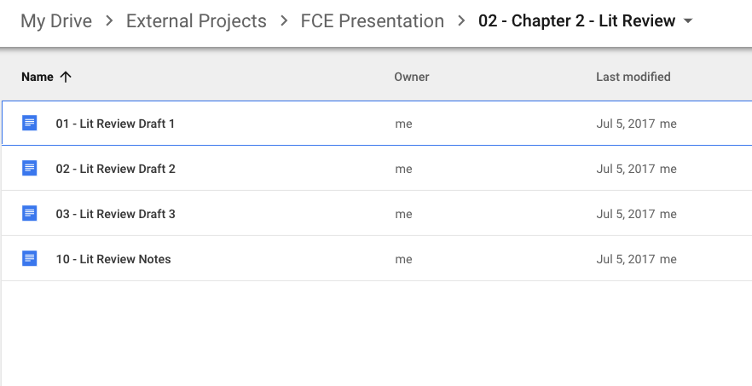

Slide 19

Find your Focus
Questions
Gaps
Disconnects
Notes:
Background: https://www.pexels.com/photo/business-identity-blank-stationery-set-on-wood-background-6372/
Use multiple media:
phone as recording device
computer/laptop – drive
journal / paper
post-its

Slide 20

Start Writing

Slide 21
Elements of your Literature Review
Introduction
  Outline your Point of Inquiry
  Identify the gap in the research that you will be responding to
  Establish your rationale for reviewing this literature and how it will be evaluated
Body
  Create a summary of each source
  Identify topic sentences
  Create links amongst sources
Conclusion
  Evaluate how these sources contribute to your thinking about the topic
  Explicitly identify how your point of inquiry relates to the sources
Notes:
https://writing.wisc.edu/Handbook/ReviewofLiterature.html

Slide 22

revise
Notes:
https://giphy.com/gifs/cat-trash-writing-l4FGvZY11MtQ92Kt2

